Slide 1
Predicting Energy Trading Prices Based On Weather And Stock Related Features
(A Multivariate Time-series Analysis)
Submitted By:
Aditya Bahukhandi (IIT2017142)
Manav Vallecha (IRM2017007)
Neelaksh Trehan (IIM2017002)
Nikhil Goyal (IRM2017005)
Under the Guidance of:
Prof. O.P. Vyas
IIIT Allahabad

Slide 2
ABSTRACT
Time series datasets have been a subject of interest in recent times. The task is imposing as the datasets are disorganised and have to be manually combined which is a tedious task. The datasets have to be merged based on the timestamp, but before that personalised weights have to be calculated for every dataset.
In this report, we illustrate the multivariate time-series analysis with the example of solar energy trading prices dataset of a major energy production hub of U.S. Weights are calculated for various states’ dataset based on individual state’s contribution to the total solar production for the hub. Finally we compare the results of ARIMA and LSTM models, which showed that LSTMs are a much better choice for handling the multivariate time series data.

Slide 3
INTRODUCTION
Time-series analysis is of utmost importance in the modern world where every industry wants to enhance its revenue by predicting the future to adjust their production, consumption or other things.
Other than business domain it can be used in monitoring physical systems, software systems, financial trading systems, weather forecasting and various other domains.
The time series dataset is a real backbreaker. Dataset combining is a hectic task in itself especially in case of a multivariate time series dataset. The datasets usually are not easily available in a single file. One has to manually combine the datasets after studying the individual datasets and getting appropriate weight for each one of them.
Here we present the right approach to combine these datasets by the exemplification of the solar energy trading prices datasets of the US government. The final dataset consisted of various features along with the daily energy trading price for the PJM West Hub.
Traditionally, time-series forecasting is done using statistical models like ARIMA, but they fail to give good results in case of multivariate time-series. We have used LSTM to predict the prices based on the various features, attributing to the fact that we had a large training set and deep learning models have been giving exceptional results on a comparatively vast dataset..
Model is trained in such a way that it learns the trend for the past thirty days and forecast the price of the current day.

Slide 4
MOTIVATION
The motivation for doing this project was primarily an interest in undertaking a challenging project in an interesting area of research.
A variety of forecasting problems can be seen around, ranging from stock price prediction to weather forecasting, all, in some or the other way, deals with time series data. We further researched the topic and came across various papers that implement Machine Learning and Deep Learning strategies in the domain of forecasting problems, this further sparked our interest to take on this project.
The best thing about time series analysis is that it can be used to predict the future as well as understand the past. This all intrigued us to explore the time-series analysis and hence, we took this project that focuses on determination of energy trading price of a hub, using a multivariate time series.

Slide 5
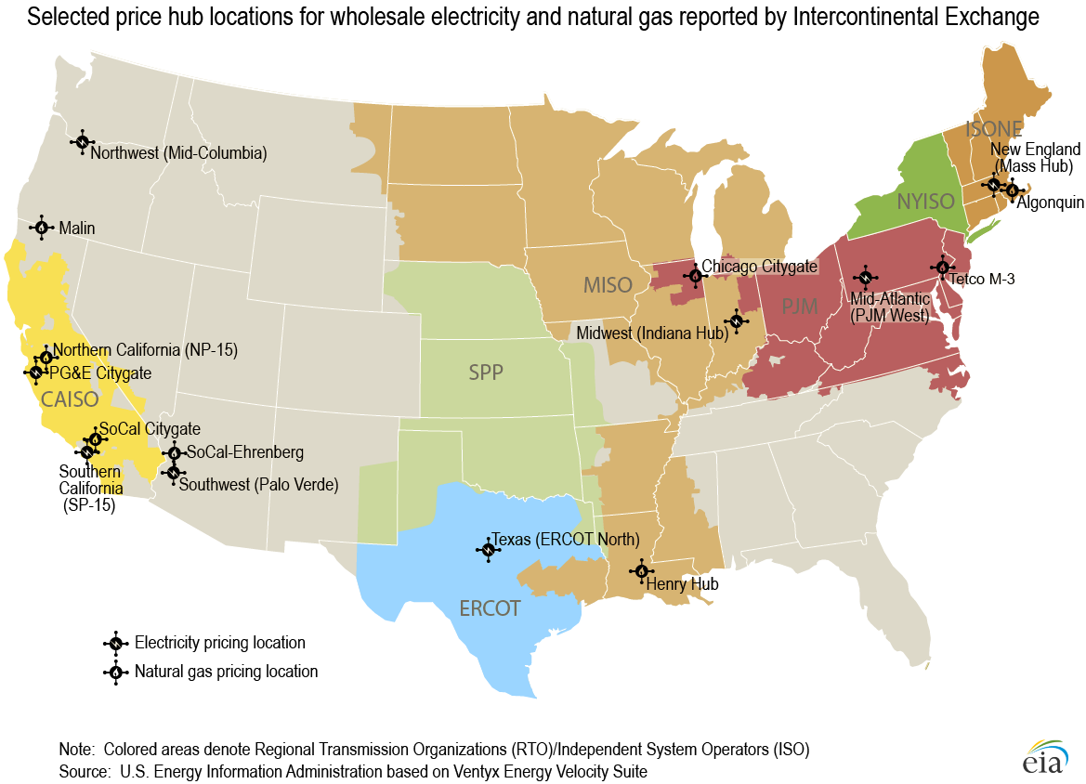
PROBLEM DEFINITION
Datasets:
Wholesale electricity Data for the PJM West Hub provided by EIA : This dataset contains daily data on electricity prices, trading volume etc for the PJM-West electricity trading hub.
State Energy Data System (SEDS), U.S. Energy Information Administration dataset : This dataset is also provided by the US Energy Information Administration(EIA) and was used to extract the solar energy production estimates for the states covered by the PJM West hub from 2000-2013.
SP index daily price data, Yahoo finance : This dataset contains the daily prices of the SP IS equity index from 2000-2013.
PSM v3.0 data, National Solar Radiation Database : Data of weather parameters like the Direct Normal Irradiance, recorded by the different Class 1 weather stations of 13 states under the PJM West hub’s territory.
We need to combine the necessary data from various datasets of various hubs, the data is of electricity prices. The availability and consumption of both of these resources is dependent on the weather, hence involve a high degree of uncertainty and a good degree of variability.
We also need to build a suitable and accurate model capable of handling the multivariate time series data and analyse its results.
Map showing various energy hubs of U.S.

Slide 6
LITERATURE REVIEW
Time series has been explored for centuries, evidence of which can be traced from the field of astronomy. Time series analysis has been mostly considered as a statistical problem under the regression analysis. Many regression models exists for time series, and they can be used for representing various stochastic processes.
The main statistical models/techniques used in the analysis of time series data are ARIMA (Autoregressive Integrated Moving Average) and ARMA (Autoregressive Moving Average). They are very much efficient for estimating appropriate values, when used on linear/univariate data.
The major difficulty while dealing with time series data is that sometimes measured data goes missing. Acknowledging this, many statistical methods, like Mean substitution, Hotdecking (substitution by other similar, complete data based on correlated characteristic) etc., have been developed for the imputation of the missing values.
While the results predicted by these regression models fit the actual trend well, they fail to do much good on time series that are often influenced by unpredictable external factors, like price series. This leads to the classification of time series into two types, Multivariate and Univariate.
Multivariate time series models can give more accurate predictions because of more number of variables involved, which makes the model more general and aware of all those variables affecting the trend.

Slide 7
LITERATURE REVIEW
This clearly demands the need of some model, that can effectively capture the multivariate time series.
While some machine learning techniques are well introduced along with the traditional time-series forecasting techniques, deep-learning techniques remains less explored. The paper by Bhaskar P. Murkhoty and Vikas Maurya on Solar Irradiation Forecasting explores how sequence to sequence deep learning models can be applied to time series data of solar irradiation to obtain good accuracies. LSTMs were found to give better accuracies than the traditional ARIMA models for long term modelling and were able to capture the more complex non-linear trends.
To prevent the overfitting and to prevent bad accuracy on the test set the cross validation technique can be used, which is basically splitting the dataset into training set, cross validation set and the test set. RMSE(root-mean-square error) can be used to evaluate the performance of the model.
The paper on Predictive Modelling of Electricity Trading Prices and the Impact of Increasing Solar Energy Penetration by Soumyo V. Chakraborty and Sandeep K. Shukla presents how predictive modelling may be done using standard Machine Learning models like SVM, Random Forests, and Gradient Boosted Decision Trees. This research analyzes the daily electricity price at two major power trading hubs namely the PJM West and Palo Verde. The major highlighting factor was that as solar penetration increased in a region, solar irradiance became more dominant weather parameter instead of temperature. The solar irradiance is the output of light energy from the entire disk of the Sun, measured at the Earth. 16 years of daily data was available and 75% of the daily data was used to train the model and 25% as a test set.

Slide 8
LITERATURE REVIEW
The major weather parameters to keep in mind for the prediction purpose are the everyday DNI (Direct Normal Irradiance), which measures the irradiation coming from the sun in a straight line, the Dry Bulb Temperature, the DHI, which accounts to the irradiation due to scattering coming from other directions.
Taking inspiration from this research, we use LSTMs for the predictive modelling of energy prices with hopes of getting a better accuracy.

Slide 9
PROPOSED METHODOLOGY
Dataset Preparation
As part of the dataset preparation first the PSM data of the 13 states under the PJM West hub territory was extracted.
One weather station from each state is chosen as it’s representative and the weighted average for each weather parameter is computed based on that state’s contribution to the total solar production for the hub. The weights were extracted from the SEDS dataset which contains the solar production estimates of each state from the years 1960-2017. We used the data from 2000-2013 for the estimation of weights.
For the next step we merged the data from the SP index data and The Wholesale electricity data and the PJM west data based on the timestamp and merged it with the processed PSM data obtained from the first step.
The data thus obtained was cleaned further to remove any missing values and redundancies that might have persisted and was normalised using the MinMaxScaler function from the sklearn library in python. The data was then split into training (80%) and test sets (20%) after sorting it by the timestamp.

Slide 10
PROPOSED METHODOLOGY
Dataset Preparation
The following 15 features were extracted :
High Price of the day
Low Price of the day
Wtd Avg Price
Daily Volume MWh
Number of Trades
Average DNI fro the day
Mean Temperature of the day
Average DHI
Mean Pressure
Wind Speed
Opening S&P index price
Highest S&P price of the day
Lowest S&P price of the day
Closing S&P index price
Volume traded

Slide 11
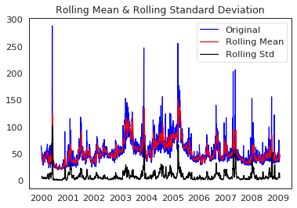
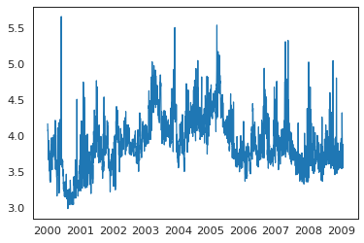
PROPOSED METHODOLOGY
Model Training : ARIMA
Before applying any statistical model, we need to ensure that our time series is stationary. As ARIMA is also a statistical model, we did the same for it.
Here the dataset consisted only of the Energy Trading Prices where indexing was done datewise.
Following two tests were used to make sure that the time series is stationary:
Rolling Statistics: Plot the rolling mean and rolling standard deviation against time. If they remain constant then the time series is stationary.
Augmented Dickey-Fuller Test: Time series is stationary if the p value according to the null hypothesis is low and the critical values for 1%, 5%, 10% confidence intervals are as close as possible to the ADF Statistics.
Rolling statistics showing the non-stationary time series
Plot of the log of the dataset

Slide 12
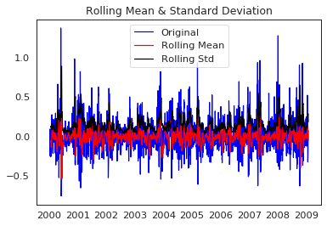
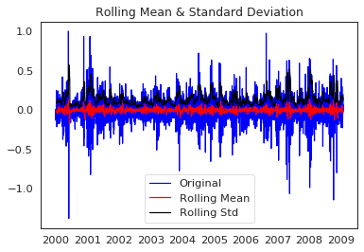
PROPOSED METHODOLOGY
Model Training : ARIMA
Now we applied a sequence of steps to make our dataset stationary. We subtracted the rolling mean on a window of 12 to get the new dataset. Now, upon applying time shifting by subtracting every point by the point that preceded it, the time series became almost stationary.
Rolling statistics after subtracting the rolling mean
Rolling statistics plot showing the shifted dataset

Slide 13
PROPOSED METHODOLOGY
Model Training : LSTM
With the necessary data cleaned we built an LSTM model with a look back value of 30. This means that the electricity price and weather parameter values of 30 days would be used in predicting the value for the 31st day at a given instant of time.
Using the keras API with tensorflow 1.2.1 as the back-end we trained an LSTM model on the data across 100 epochs using a single Dense layer keeping the Dropout as 0.2. This is done so as to introduce some randomness into the network so that it does not overfit the training set.
Mini batch gradient descent was used with batch size as 64 and ADAM as the optimizer, ensuring faster convergence to an optimum value. Early stopping is also used to control over-fitting to the training set.

Slide 14
SOFTWARE
REQUIREMENTS
HARDWARE
REQUIREMENTS
Google Chrome
A google account that has access to google collaboratory
Python 3.6
Tensorflow v1.14 with keras API
Pandas, Numpy, Sklearn, statsmodels python libraries
matplotlib and seaborn libraries for plotting purposes
Spyder IDE or Jupyter Notebook
Any machine that supports the Google Chrome web browser
GPU for training and testing the machine learning model

Slide 15
IMPLEMENTATION PLAN
Pre Mid-Sem :
We successfully extracted combined the SP index data from yahoo finance and PJM west electricity price data available from EIA.
Studied machine learning techniques Artificial Neural Networks and LSTM and how these could be applied for time series forecasting.
TASK | StartDate | End Date
Literature review | 11-08-2019 | 05-10-2019
Finalizing Problem Statement and Goals | 25-08-2019 | 27-08-2019
Gathering and Pre-processing of data | 20-08-2019 | 25-10-2019
Training and testing of models | 01-11-2019 | 12-11-2019
Implementation Timeline

Slide 16
IMPLEMENTATION PLAN
Post Mid-Sem :
Explored the TMY3 dataset that contained old data of weather parameters from the years 1990-2003. We also observed that the data was not continuous which would have proven to be detrimental to the modelling process. Also different class I weather stations had missing data on different dates so combining them had become a real problem.We therefore used the PSM v3.0 data from NSRDB instead which had continuous data of the weather parameters of the class I weather stations in a continuous fashion and from the required years 2000-2013.
Fully combined the necessary data from four datasets, namely Wholesale electricity Data for the PJM West Hub provided by EIA, the SP index daily price data from Yahoo finance PSM v3.0 data from the National Solar Radiation Database and the SEDS dataset from EIA and obtained the dataset that was used for the training of the models.
Built an ARIMA model and compared it with the LSTM model.
Built an LSTM model and trained it on google collab to predict the next day’s electricity price of the hub based on 30 previous days parameter values.

Slide 17
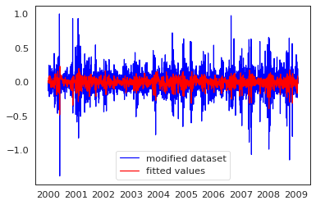
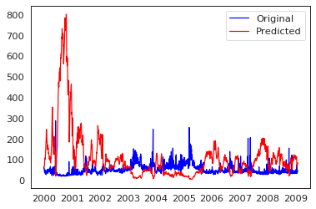
RESULTS
ARIMA
Three integers (p, d, q) are typically used to parametrize ARIMA models.
p: number of autoregressive terms (AR order)
d: number of non seasonal differences (differencing order)
q: number of moving-average terms (MA order)
We finally applied the dataset after all the transformations into the ARIMA model, with p, d and q set as 2, 1 and 2, and got the result.
Finally we inverted all the previously applied transform on the original dataset, to get the real predicted value with respect to the original dataset and got the result.
Root mean square error in ARIMA model came out to be 7918.05.
Predicted and the modified dataset Prices, ARIMA
Predicted and Original Prices, ARIMA

Slide 18
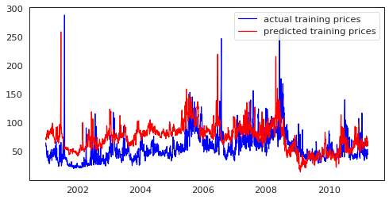
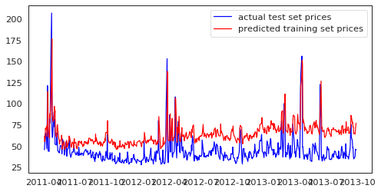
RESULTS
LSTM
The LSTM model that we used for training yielded the results that can be seen through the plots.
Results on Training Data:
Mean Absolute Error: 21.70
Root Mean Squared Error: 25.19
Results on Test Data:
Mean Absolute Error: 21.62
Root Mean Squared Error: 24.06
Plot showing the predicted vs the original prices in the training dataset,
LSTM
Plot showing the predicted vs the original prices in the test dataset, LSTM

Slide 19
REFERENCES
Image taken from https://www.eia.gov/electricity/wholesale/ [Online Image]
Pasapitch Chujai, Nittaya Kerdprasop, and Kittisak Kerdprasop, “Time Series Analysis of Household Electric Consumption with ARIMA and ARMA Models”, International MultiConference of Engineers and Computer Scientists 2013 Vol I, IMECS 2013, March 13 - 15, 2013, Hong Kong
Y. S. Afrianti, S. W. Indratno and U. S. Pasaribu, “Imputation algorithm based on copula for missing value in timeseries data”, 2014 2nd International Conference on Technology, Informatics, Management, Engineering Environment, Bandung, 2014, pp. 252-257. doi: 10.1109/TIME-E.2014.7011627
Y. Zhao and L. Shen, “Application of time series auto regressive model in price forecast”, 2011 International Conference on Business Management and Electronic Information, Guangzhou, 2011, pp. 768-771. doi: 10.1109/ICBMEI.2011.5921078
S. Lei, C. Sun, Q. Zhou and X. Zhang, “The research of local linear model of short term electrical load on multivariate time series”, 2005 IEEE Russia Power Tech, St. Petersburg, 2005, pp. 1-5. doi: 10.1109/PTC.2005.4524543
Bhaskar Pratim Mukhoty, Vikas Maurya, Sandeep Kumar Shukla, “Sequence to sequence deep learning models for solar irradiation forecasting”, Indian Institute of Technology Kanpur.

Slide 20
REFERENCES
A. Sarah, K. Lee and H. Kim, “LSTM Model to Forecast Time Series for EC2 Cloud Price”, 2018 IEEE 16th Intl Conf on Dependable, Autonomic and Secure Computing, 16th Intl Conf on Pervasive Intelligence and Computing, 4th Intl Conf on Big Data Intelligence and Computing and Cyber Science and Technology Congress(DASC/PiCom/DataCom/CyberSciTech), Athens, 2018, pp. 1085-1088.
Vladimir Stojov, Nikola Koteli, Petre Lameski, Eftim Zdravevski, “Application of machine learning and time-series analysis for air pollution prediction”, CiiT 2018 - 15th International Conference on Informatics and Information Technologies, 2018, Mavrovo, Macedonia.
Soumyo V. Chakraborty and Sandeep K. Shukla, “Predictive Modeling of Electricity Trading Prices and the Impact of Increasing Solar Energy Penetration”, Indian Institute of Technology Kanpur.

Slide 21
THANK YOU !!

